Slide 1

SANSKRITHI SCHOOL OF ENGINEERING
DEPARTMENT OF COMPUTER SCIENCE AND ENGINEERING
Final Project Review
on
“E-LEARNING AND CAMPUS INFORMATION SYSTEM”
Submitted By
UNDER THE GUIDENCE OF
Mr. O.Bhaskar _{M.Tech,(Ph.D).,}
Assistant Professor
Department of Computer Science and Engineering
Sanskrithi School of Engineering
Puttaparthi - 515134
K.PARIMALA | 18KF1A0525
B.HARITHA | 18KF1A0509
K.UDAY | 18KF1A0524
K.SAI JOSHNA | 18KF1A0528
N.VIJAYA SAI | 18KF1A0538

Slide 2
Agenda
Abstract
Introduction
Literature survey
Existing System
Proposed System
System Requirements
Block Diagram
Modules
UML diagrams
Implementation Snapshots
Conclusion
References

Slide 3
Abstract
In the last decade, with the ever increasing use of new services have emerged. Several studies showed that students are relying on these new technologies to achieve different tasks .The aim of this site is to provide a single platform for students and the staff to interact with each other, such as discussing their queries, uploading and viewing the study materials, chatting with each other, attending the quiz provided by the staff members, uploading their messages, images and videos in their timeline, viewing the notices published by the staff members . The admin of this site takes care of the activities such as adding and removing of courses, subjects, students and staff members and publishing notices.

Slide 4
Introduction
E-learning is the 'learning' process revolution enabled by new technologies that, hopefully, will present an effective and efficient learning process that doesn't exist today. The administrator has the most authority.
It will promote teaching and learning through a more dynamic platform. It provides user features to follow the students, send message to others, post what they like and ask for some queries on which like and comment feature is available .
In this project a social media platform for college campus has been created where everyone associated with the college campus such as students, staff members can socialize with each other and share their knowledge about academics, projects, placements and all other activities going on in the campus.

Slide 5
Objectives of the project
Admin has full authority of the website to manage students, faculties, question & answers, result, examination, course, events etc.
The faculties can upload study materials through online. The students can view uploaded study materials by faculties.
The project has individual and group chat feature where students can chat with faculties.
Problem Statement
The website have some more extra features to directly contact with the faculties to clarify their doubts in chat system and students can download the materials. The staff can conduct quizzes in this application.

Slide 6
Mobile Intra-Campus Student Social Network[1]
LITERATURE REVIEW
Ibrahaim , Emad abdallah
This application provides only social network for students. It cannot have separate discussion for each department. There are no instructors for monitorization. Messages are visible to all students.
Disadvantages :
Faculties don’t have permission to upload the materials and to conduct quizzes.
Admin don't have permission to send notice for all students.
Students don’t have permission to ask questions for faculties.

Slide 7
LITERATURE REVIEW
A study of Social Network Applications[2]
Dr. Mohammed , Yahiya Alghamdi
Social network applications have a major impact on young people and also helped to gain importance in academic life. These tools provides the facility of the social network and it also encourages the process of traditional teaching.
Disadvantages:
No involvement of staff for communication.
Methodology is used only for maintenance of student discussion.
The students have individual profile for the purpose of communication.

Slide 8
LITERATURE REVIEW
Android Based Student Learning System[3]
Vineeth singh, Lucala Bay
In the existing system there are different modules such as activities due dates, exam alert and discussion notifications. It also have tutorial tool for students to reduce paper work .
Disadvantages:
Students don’t have permission to access the study materials and quizzes.
This application doesn’t manage large number of students.

Slide 9
LITERATURE REVIEW
Academic usage of Social Networking Sites[4 ]
R. Subraman
Social-networking sites are interactive due to the availability of chat rooms, discussion forums, and network-based gaming applications. Therefore, unlike regular Web sites, online social networks provide a way to connect and have fun with contacts.
Disadvantages:
There is a limit of users in the application.
It is complicate to download pdfs and materials.
Absence of raising questions by students.

Slide 10
LITERATURE REVIEW
A Student Information System[5 ]
Prabhu T Kannan, Sri vidya
Student information is available to administrators across the institution, In which it facilitates planning and coordination. Learning Management System is a software application to share course content and track the progress of individual students.
Disadvantages:
Students cannot access the study materials and quizzes.
The discussion panel is not there for students.
Admin only to monitories all things in modules.

Slide 11
EXISTING SYSTEM
In that students communicate with their daily activities. Campus information not there in the social network system. The admins only view the chatting in discussion sessions. Students cannot access the study materials and quizzes in the panel. In each degree they don’t have to permission to discuss subject related questions. All students chat with all in the one module only.
Disadvantages:
Faculties not there in the previous methodologies , They cannot provided faculty login panels.
Notices doesn’t provide in the timelines bar.
Students cannot acce ss the study materials and quizzes in the panel.
In the previous all members discussion in one panel.

Slide 12
PROPOSED SYSTEM
In these students communicate with their daily activities. The site will provide campus information and timeline notices in the application. Admin to control the all activities in the application. Students have permission to access the study materials and quizzes in the panel. In each degree they have a permission to discuss subject related questions. Different modules for student discussion in the application.
Advantages:
The faculties can upload study materials through online.
Notices to provide in the timelines bar.
Students to access the study materials and quizzes in the panel.
In the application to provides the contact information for college management.

Slide 13
SYSTEM REQUIREMENTS
Hardware Requirements:
Processor - I3 / Intel Processor and Above
Hard Disk - 256 GB
RAM - 2GB and Above
Software Requirements:
Operating System - Windows 7 and Above
Software - visual studio, Apache server, Chrome
Programming Languages :
Front end - HTML, CSS, JAVASCRIPT
Backend - MySql, PHP

Slide 14




Block Diagram
Database
Login
Request
Controlling
Activities
Response
Institution
Admin and faculty
Login
Accessing resources
Basic workflow system
Enhanced system workflow
Students
Fig 1 : Block diagram for E-Leaning and campus information system

Slide 15
Modules
Admin and Staff Module
Student Module
Campus Information Module

Slide 16
Admin and Staff Module
Dashboard Module :-This dashboard module is for administrator where admin can manage complete control of the website. Admin is the super user of the website.
Add Students:-In this the faculity can add the students according the semester and branch.
Maintain the Discussion of Messages:-In this module students can send questions in the discussion panel. The faculties can answer to all students’ questions. All the question and answer records stores in the discussion panel. All students can view discussion panel records.
Upload Student materials:-In this module the faculties can upload notes and documents by entering book details. This helps students to refer for exam, studies, etc.
Publishing Notices:-In this panel the admin can publish the notices like timelines and events.

Slide 17
Add Course:- In this panel the admin can add the course according to the student .
Add Subject:- In this panel the admin can add the subjects according to the course of the students.
Maintain the Database:- In this panel the admin can maintain the total databases of all the project .

Slide 18
Student Module
Group Discussion:-In this module students can send questions in the discussion panel. The faculties can answer to all students’ questions. All the question and answer records stores in the discussion panel. All students can view discussion panel records.
Quizz module:-This module provides a common platform to connect students and faculties online. The faculty can create Quiz and student can take up quiz. The quiz result and point system will display in the student account panel.
Downloading Study Materials:-In this module students can download the study materials according to the course and the branch.

Slide 19
Maintain Profile:-The students can create their own profile according to their details and maintain securely.
Chatting with Friends:-This allows users to chat with their friend circles. Users can send invitation to their friends to join the chat system.

Slide 20
Campus Information Module
Timeline Notices:-Timeline notices are a quick and easy way to watch for notable changes related to college.
About College:-This module is used to provide information about college.
Contact us :-This module is used to communicate with college management by calling or sending them a letter, email.

Slide 21
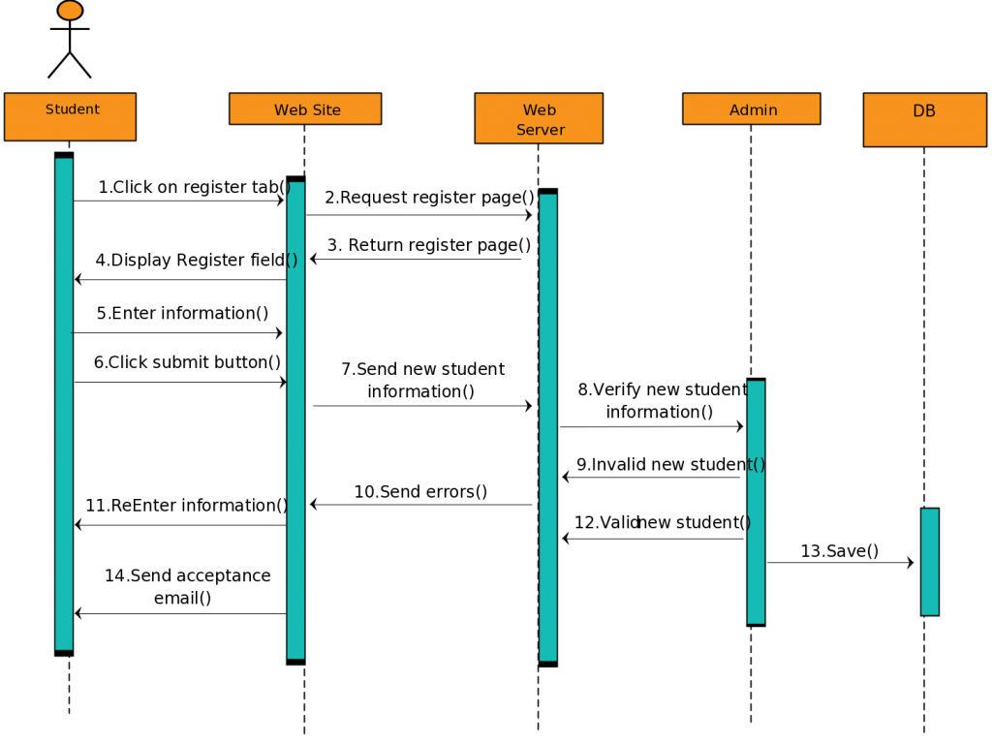
Sequential Diagram
Fig 2 : Sequential diagram for E-Learning and campus information system

Slide 22
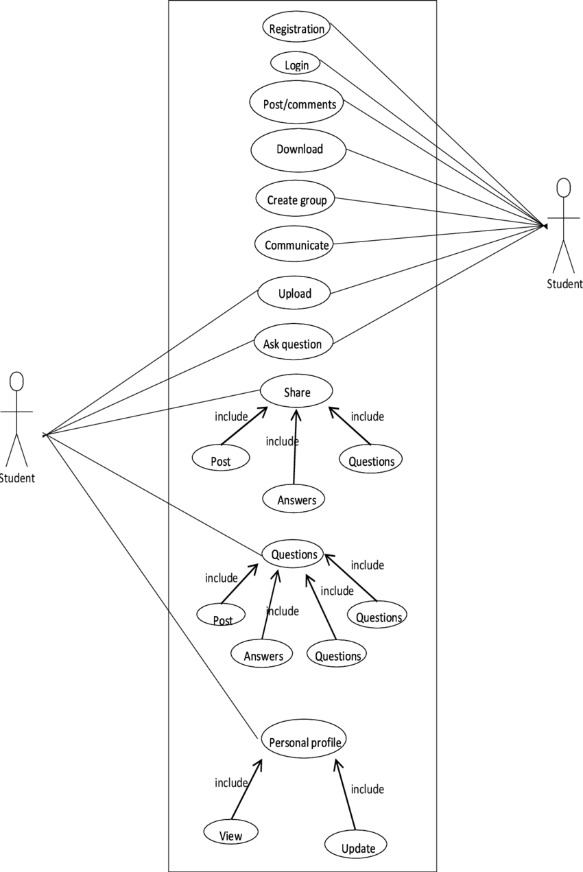
Use Case Diagram
Admin and faculty
Fig 3: use case diagram For E-Leaning and campus information system

Slide 23
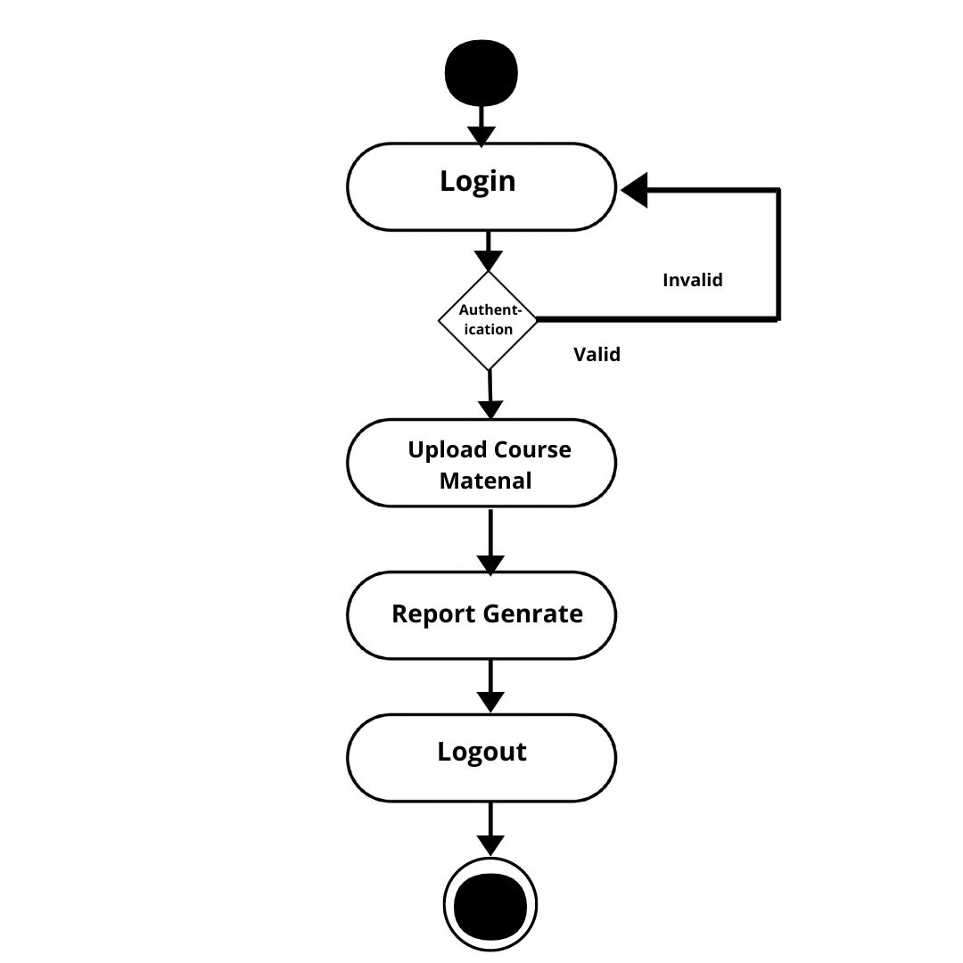
Activity diagram for faculty module
Fig 4 : Activity diagram

Slide 24
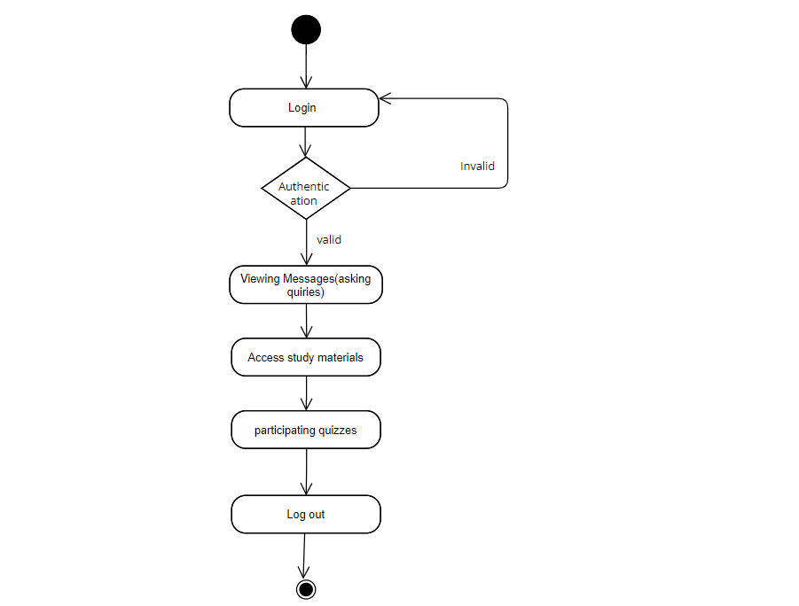
Activity diagram for Student module
Fig 5 : Activity diagram

Slide 25
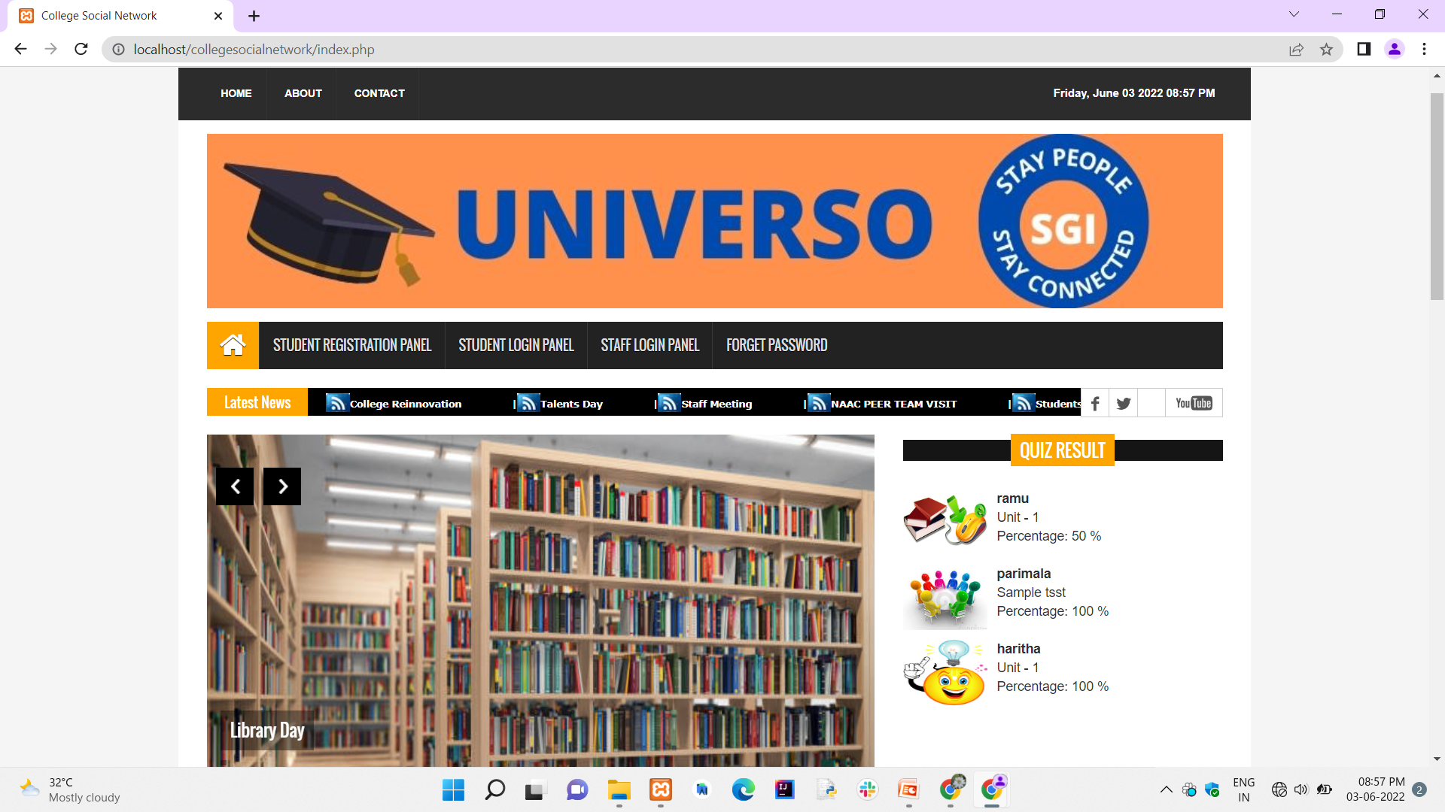
Implementation Snapshots
Home Page

Slide 26
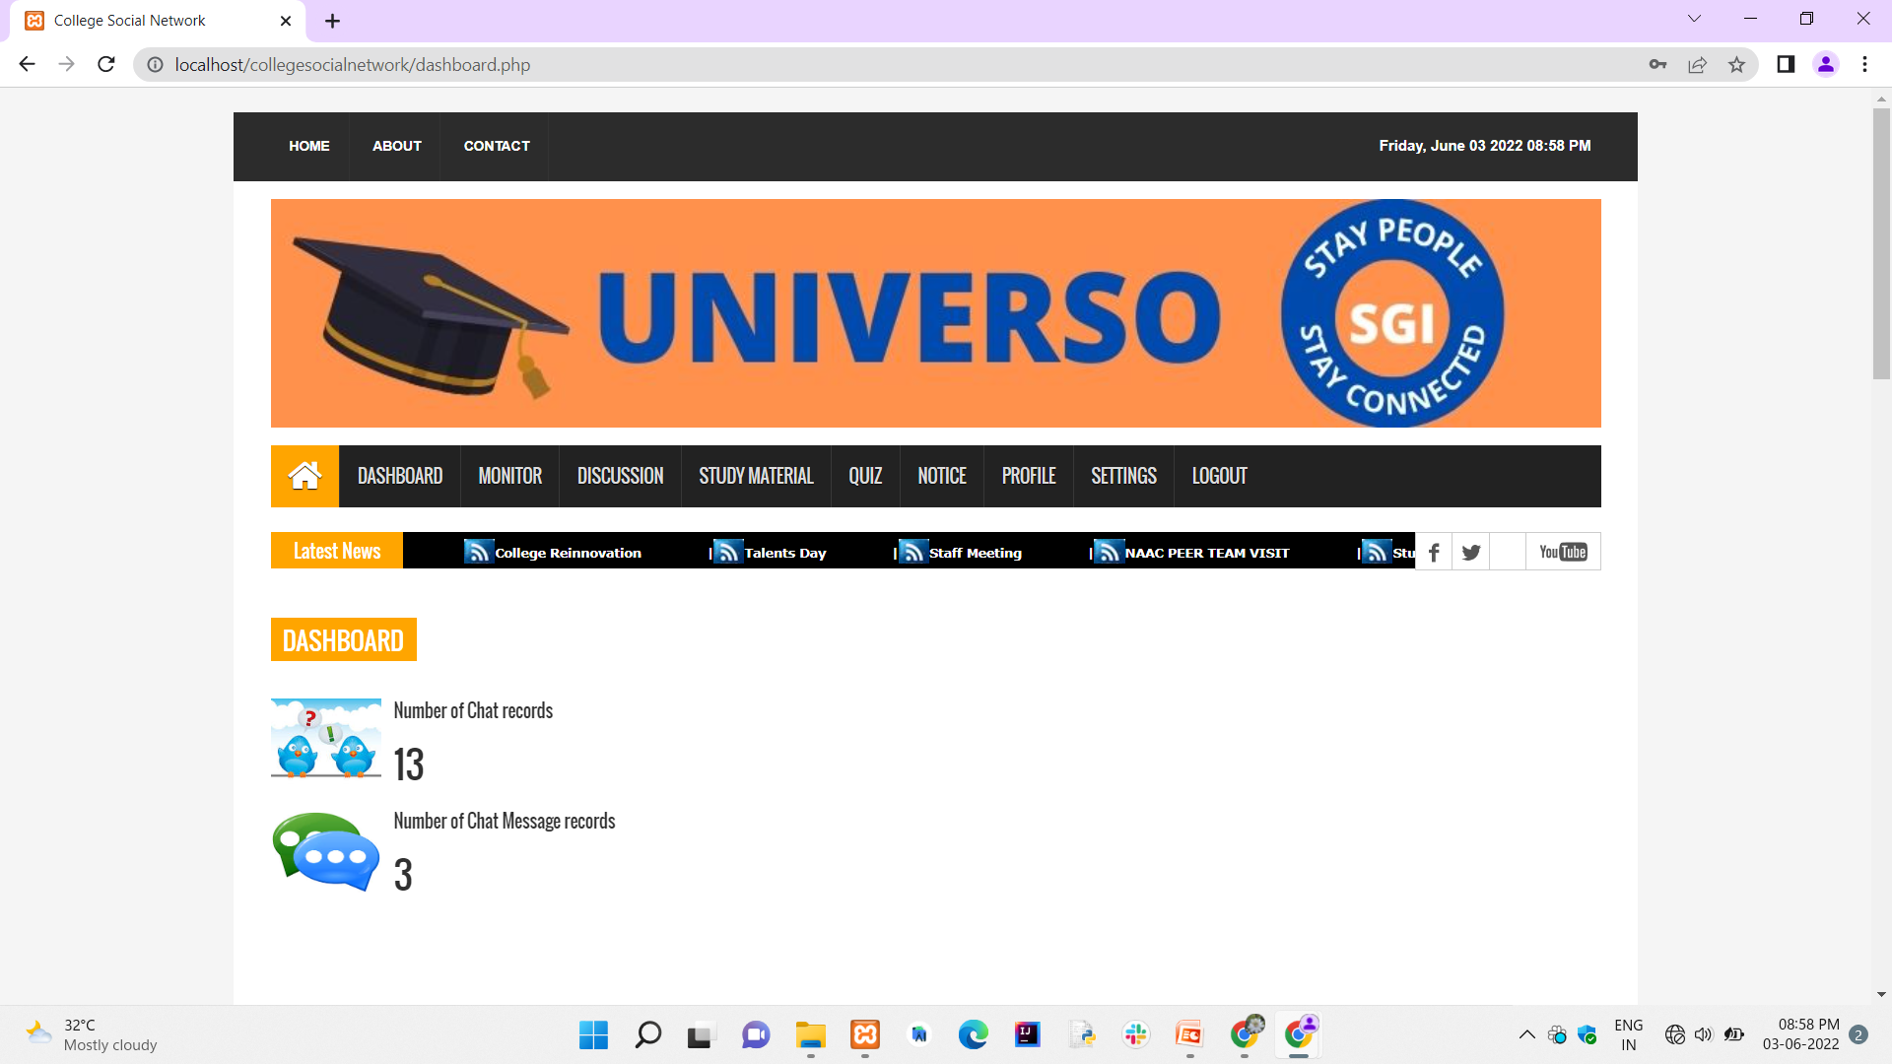
Admin & Staff Module

Slide 27
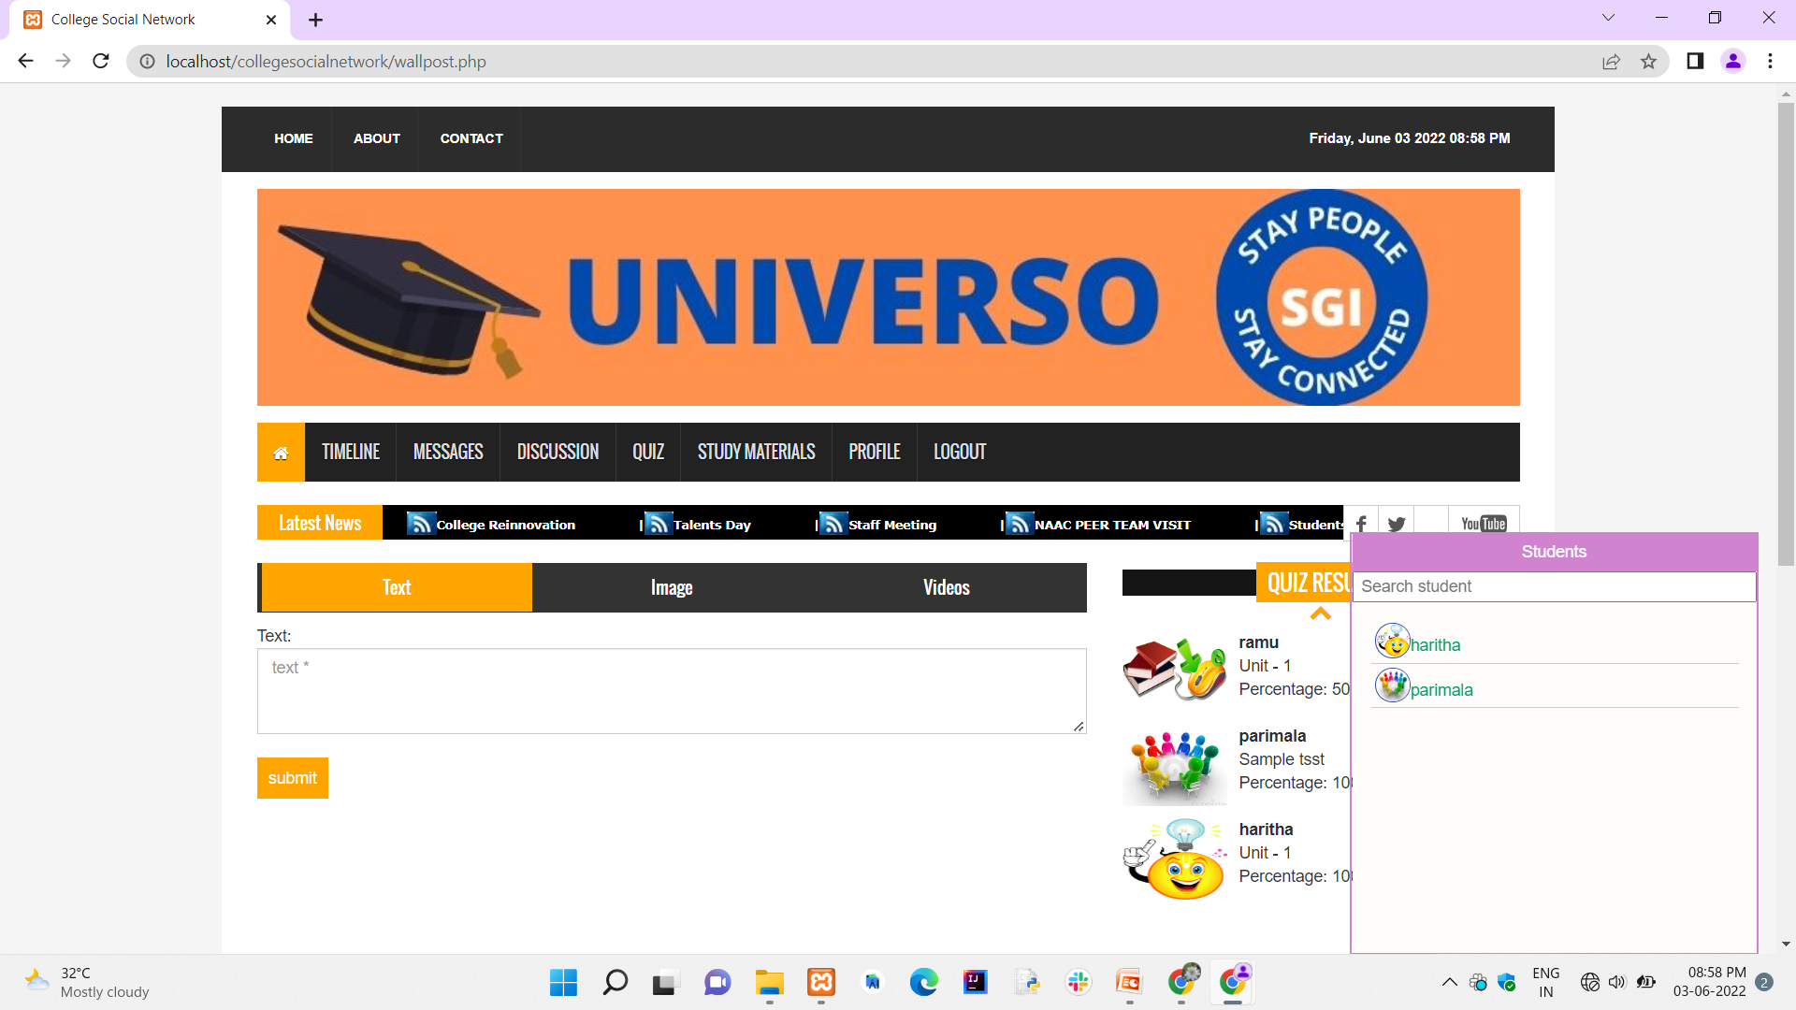
Student Module

Slide 28
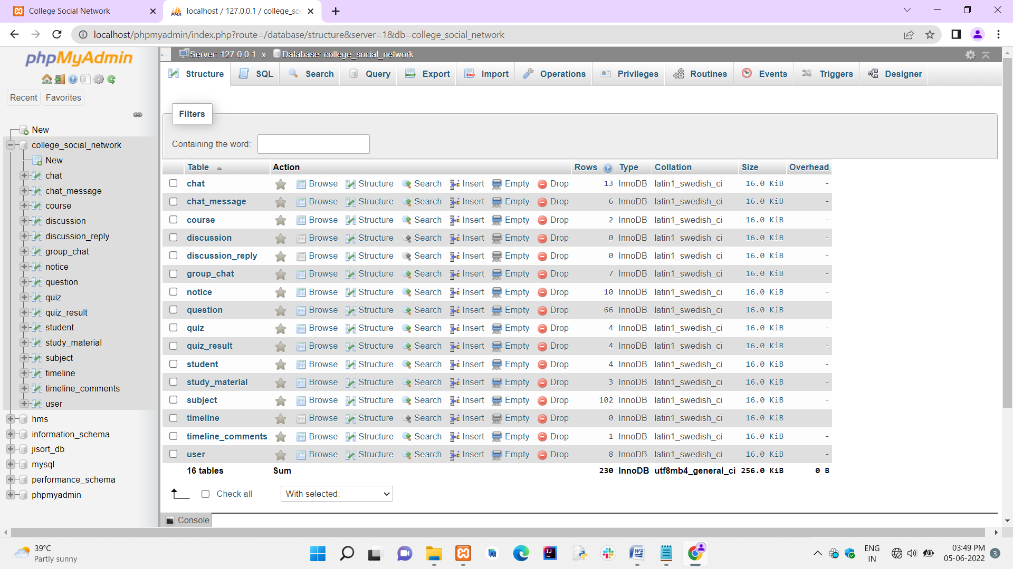
Database Module

Slide 29
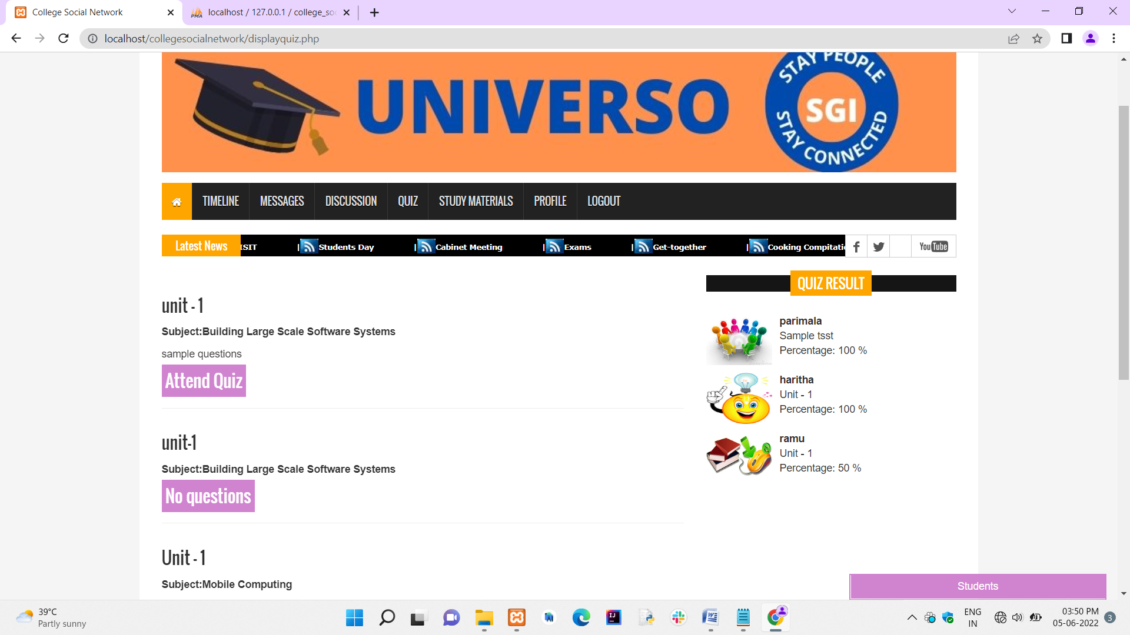
Discussion Module

Slide 30
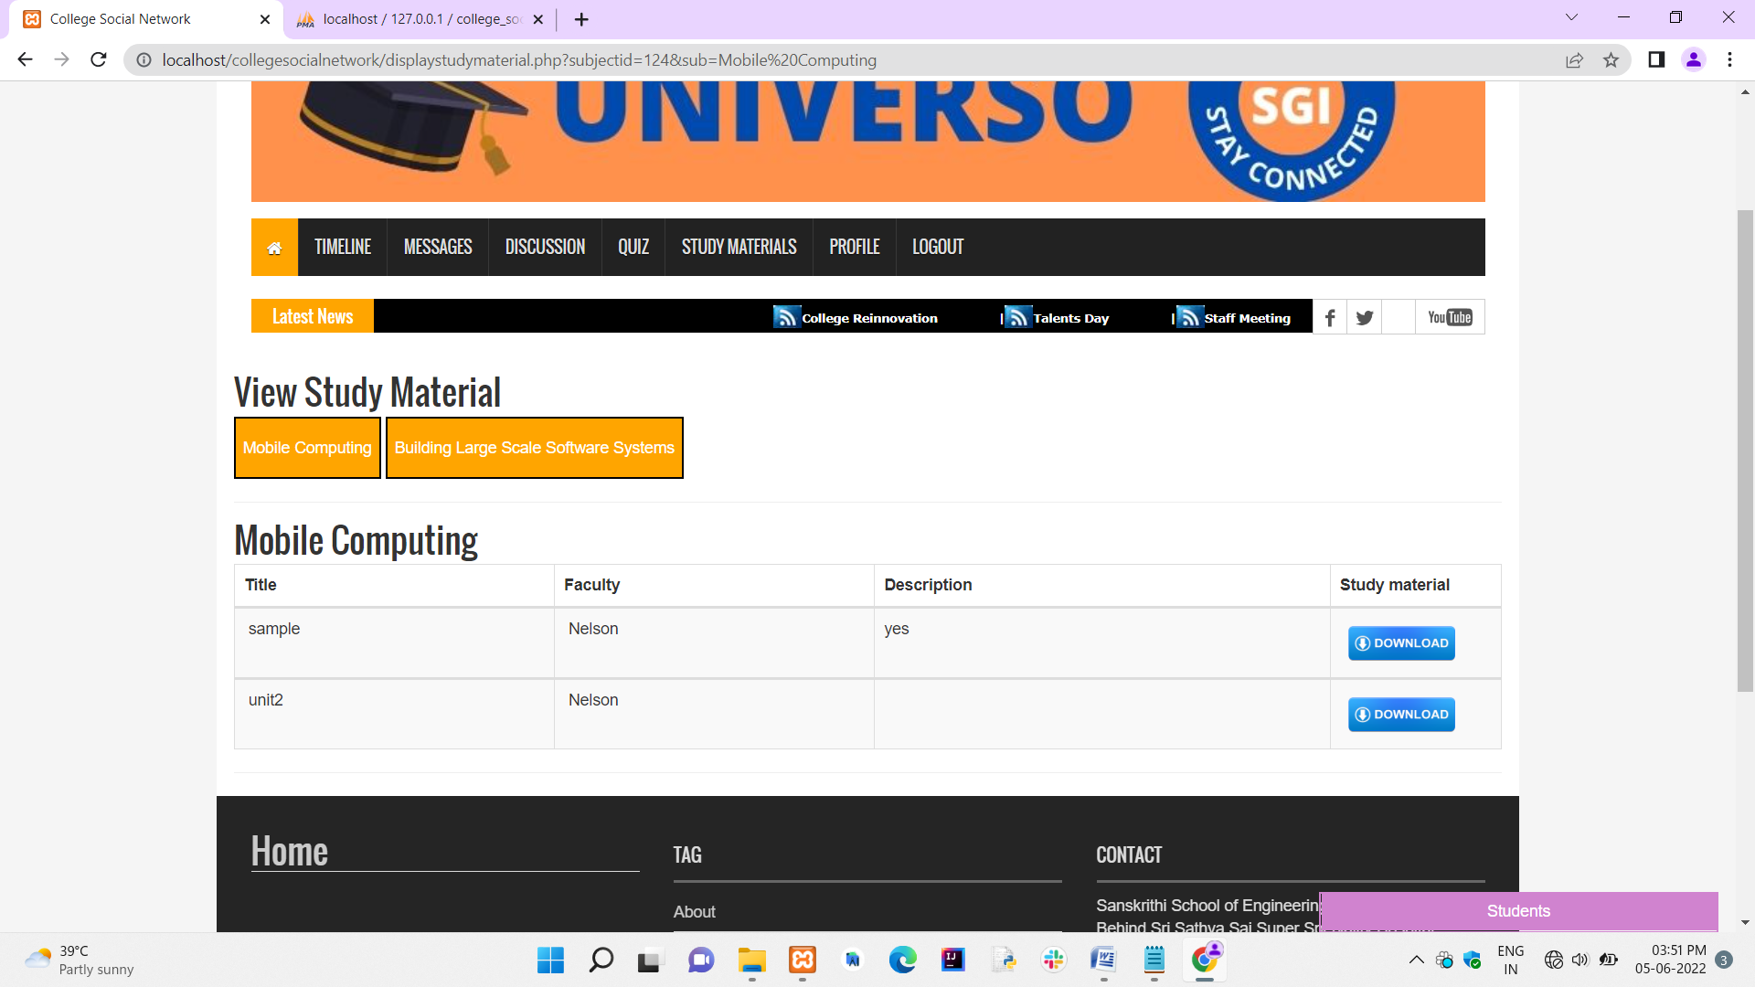
Study material Module

Slide 31
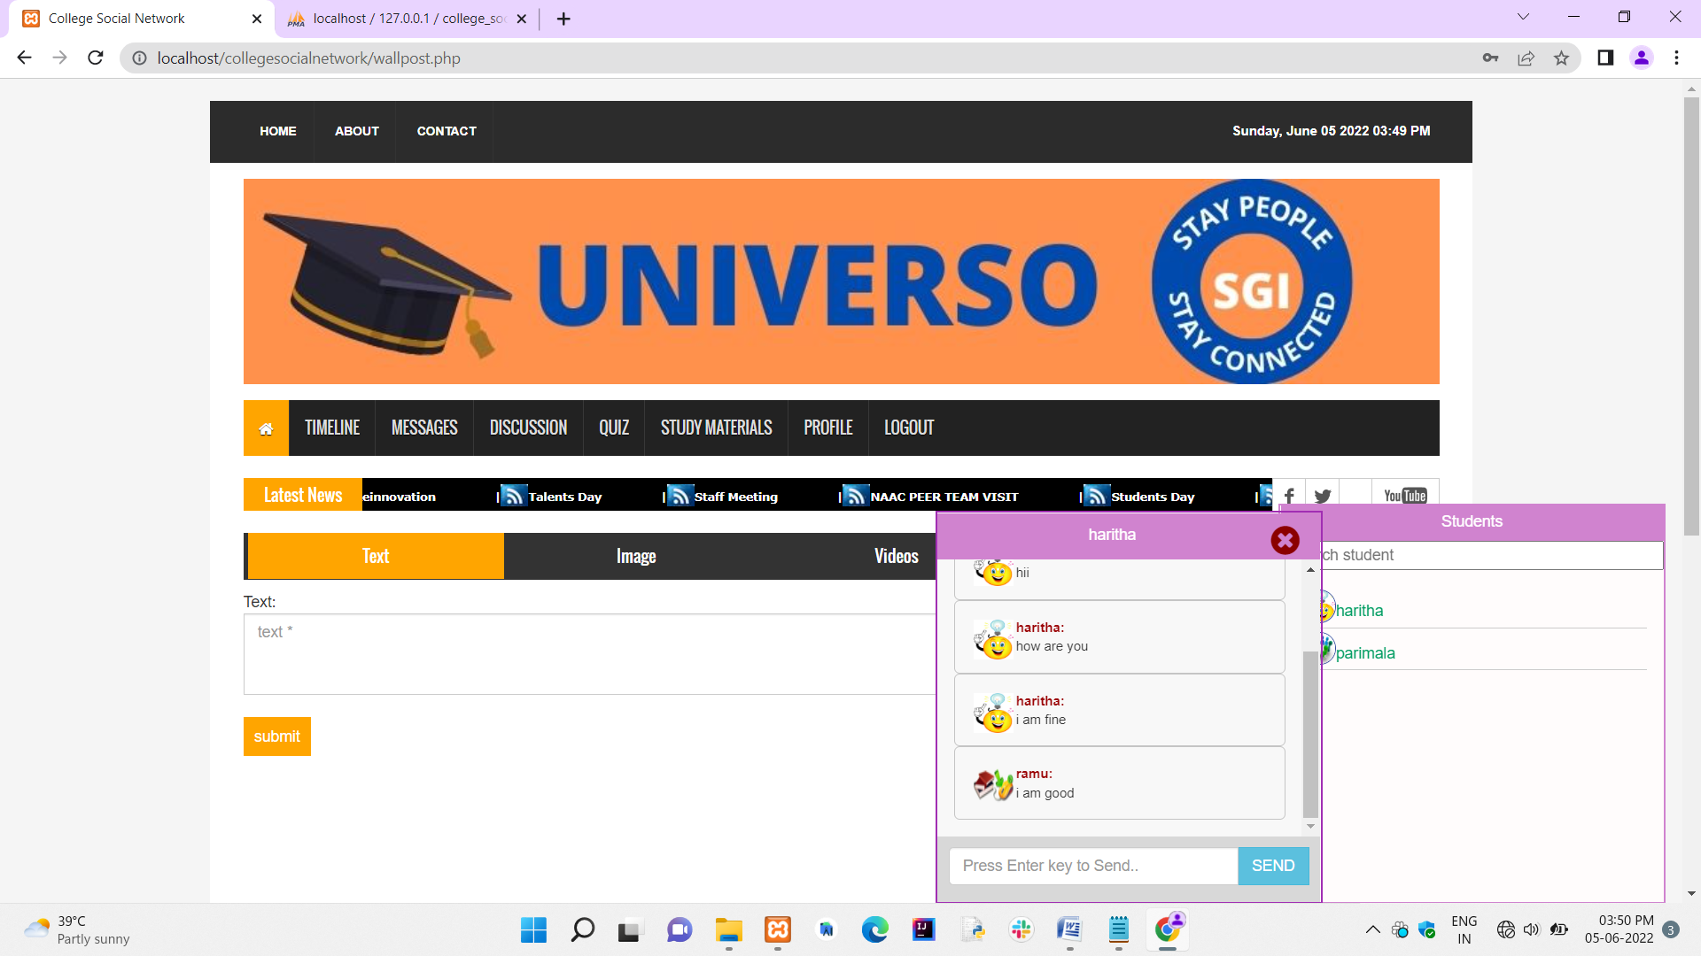
Individual chat Module

Slide 32
Conclusion
The project work titled “E-Learning and Campus Information System” has been designed using PHP – Hypertext Pre Processor where in many user friendly form controls have been added in order to make it a user interactive application.
The system is developed in such a way that the user with common knowledge of computers can handle it easily. This website makes it easy for the Sanskrithi school College to interact with their staffs and students in single platform.
It was a wonderful learning experience while working on this project. This project took us through the various phases of project development and gave us real insight into the world of software designing.

Slide 33
REFERENCES
[1] Ibrhaim Al-Oqily, Emad Abdallah and Alaa Abdallah developed on “Mobile Intra-Campus Student Social Network”. IEEE paper published on 2019.
[2] Dr.Mohammed yahya Alghamdi developed on “A study of Social Network Applications”. IEEE paper published on 2020.
[3] Dr. Vineeth singh developed on “Android Based Student Learning System”. IEEE paper published on
[4] Dr. R. Subraman developed on “Academic usage of Social Networking Sites”. IEEE paper published on 2019.
[5] Dr. Prabhu T Kannan, Sri vidya developed on “A Student Information system”. IEEE paper published on 2018

Slide 34
THANK YOU

